Slide 1
COMPUTER ORGANIZATION AND ARCHITECTURE
Lecture No.2

Slide 2
TODAY’S TOPIC
Bus structures
Memory locations and addresses

Slide 3
BUS STRUCTURE:
The simplest and most common way of interconnecting various parts of the computer.
To achieve a reasonable speed of operation, a computer must be organized so that all its units can handle one full word of data at a given time.
A group of lines that serve as a connecting port for several devices is called a bus.
In addition to the lines that carry the data, the bus must have lines for address and control purpose.
Since the bus can be used for only one transfer at a time, only two units can actively use the bus at any given time.
Bus control lines are used to arbitrate multiple requests for use of one bus.

Slide 4
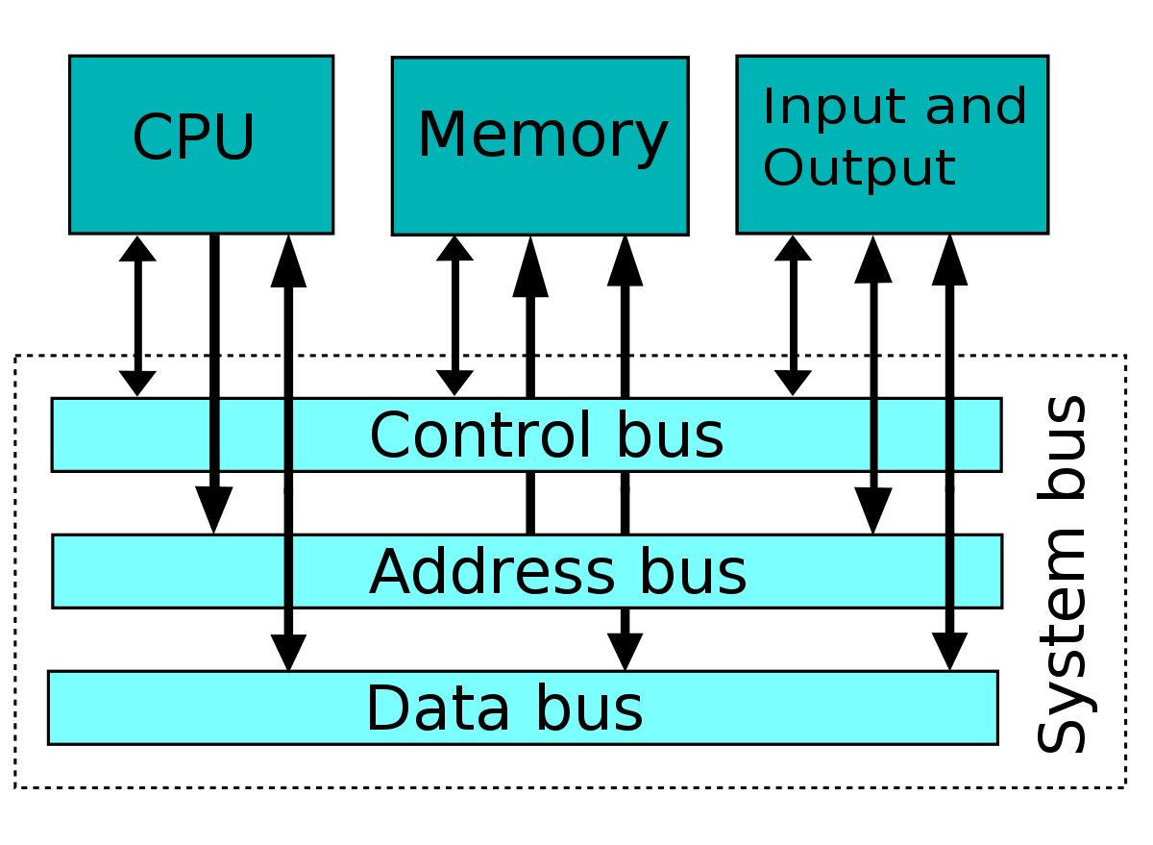

Slide 5
MEMORY LOCATIONS AND ADDRESSES
Number and character operands, as well as instructions, are stored in the memory of a computer.
The memory consists of many millions of storage cells, each of which can store a bit of information having the value 0 or 1.
Because a single bit represents a very small amount of information, bits are seldom handled individually.
The usual approach is to deal with them in groups of fixed size.
For this purpose, the memory is organized so that a group of n bits can be stored or retrieved in a single, basic operation.
Each group of n bits is referred to as a word of information, and n is called the word length.
Modern computers have word lengths that typically range from 16 to 64 bits.

Slide 6
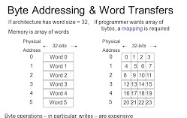
Accessing the memory to store or retrieve a single item of information, either a word or a byte, requires distinct names or addresses for each item location.
BYTE ADDRESSABILITY:-
We now have three basic information quantities to deal with: the bit, byte and
word. A byte is always 8 bits, but the word length typically ranges from 16 to 64 bits.
The most practical assignment is to have successive addresses refer to successive byte Locations in the memory.

Slide 7
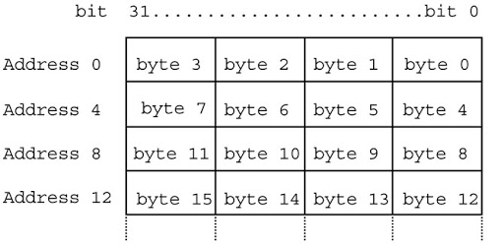
The term byte-addressable memory is use for this assignment.
Byte locations have addresses 0,1,2, ....
Thus, if the word length of the machine is 32 bits, successive words are located at addresses 0,4,8,...., with each word consisting of four bytes.

Slide 8
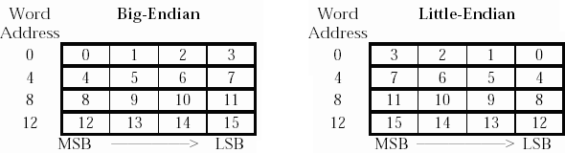
BIG-ENDIAN AND LITTLE-ENDIAN ASIGNMENTS:-
There are two ways that byte addresses can be assigned across words,
The name big-endian is used when lower byte addresses are used for the more significant bytes (the leftmost bytes) of the word.
The name little-endian is used for the opposite ordering, where the lower byte addresses are used for the less significant bytes (the rightmost bytes) of the word.
In addition to specifying the address ordering of bytes within a word, it is also necessary to specify the labeling of bits within a byte or a word.
The same ordering is also used for labeling bits within a byte, that is, b7, b6, ...., b0, from left to right.

Slide 9
WORD ALIGNMENT:-
In the case of a 32-bit word length, natural word boundaries occur at addresses 0,4, 8, ...,. We say that the word locations have aligned addresses.
In general, words are said to be aligned in memory if they begin at a byte address that is a multiple of the number of bytes in a word. The memory of bytes in a word is a power of 2.
Hence, if the word length is 16 (2 bytes), aligned words begin at byte addresses 0,2,4,..., and for a word length of 64, aligned words begin at bytes addresses 0,8,16 ....

Slide 10
ACCESSING NUMBERS, CHARACTERS, AND CHARACTER STRINGS:-
A number usually occupies one word. It can be accessed in the memory by specifying its word address.
Similarly, individual characters can be accessed by their byte address.
In many applications, it is necessary to handle character strings of variable length.
The beginning of the string is indicated by giving the address of the byte containing its first character.
Successive byte locations contain successive characters of the string.
There are two ways to indicate the length of the string.
A special control character with the meaning “end of string” can be used as the last character in the string, or a separate memory word location or processor register can contain a number indicating the length of the string in bytes.

